Slide 1
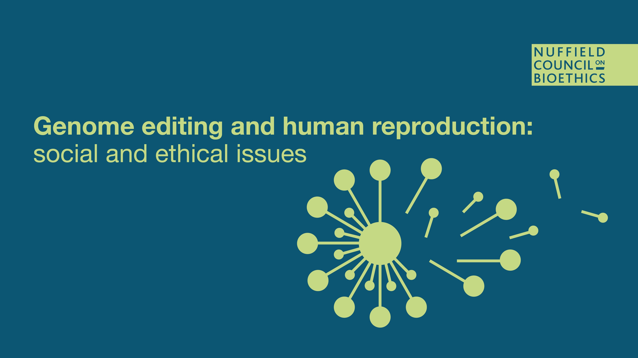
Pete Mills, Assistant Director
Nuffield Council on Bioethics (UK)

Slide 2
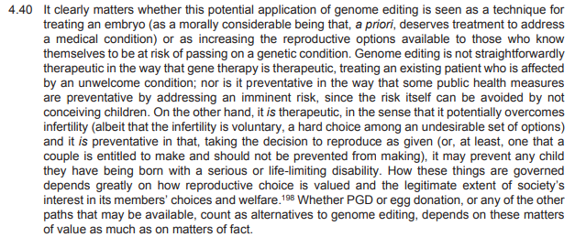

What are heritable genome editing interventions?

Slide 3
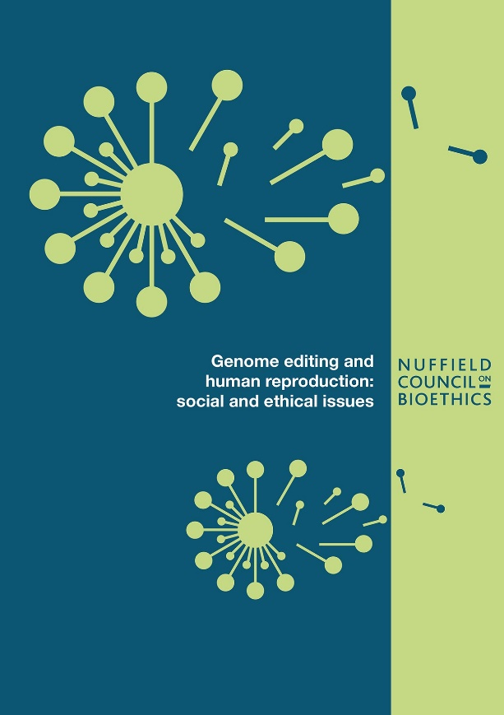
What’s new?
People approach reproduction in
novel epistemic position (genomic research, genetic testing)
novel sociotechnical conditions (ARTs, reprogenetics… genome editing?)
But why genome editing?
Is there an unmet need?
Isn’t there a moral prohibition?

Slide 4


Genome editing as emerging biotechnology
dynamic relationship between technology and norms
transformative technology?
what role for moral agency?
what next?

Slide 5
Relating interests and responsibilities
Humanity
(human dignity)
the categorical problem
Society
Other cultures, future generations
social justice and solidarity
the distributional problem
Family
Others
welfare of the future person
the substantive problem
Prospective parents
Offspring

Slide 6
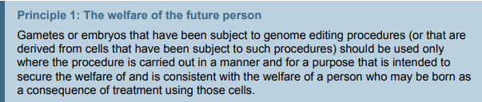
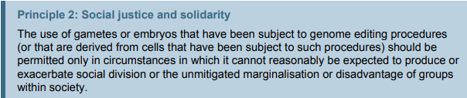
Principles

Slide 7
Conclusions
Heritable genome editing interventions could be morally permissible in certain circumstances
Two principles; 15 recommendations, including:
Research and public debate are needed before legal change
Responsible governance measures should be put in place
Licensing and regulatory controls are essential
Elaborate governance within human rights framework

Slide 8
Three venues of ‘geo-ethics’
Republic of science
Cosmopolitan ethics
International law and human rights
Is there an ‘international consensus’?
Knowledge, technologies and people are highly mobile
‘Artefacts have ethics’
Local responses elaborate networks of interdependent moral norms, rooted in implicit knowledge and culture
There is a need for “for international, interdisciplinary and cosmopolitan reflection on the progress of thinking on these issues around the world”

Slide 9
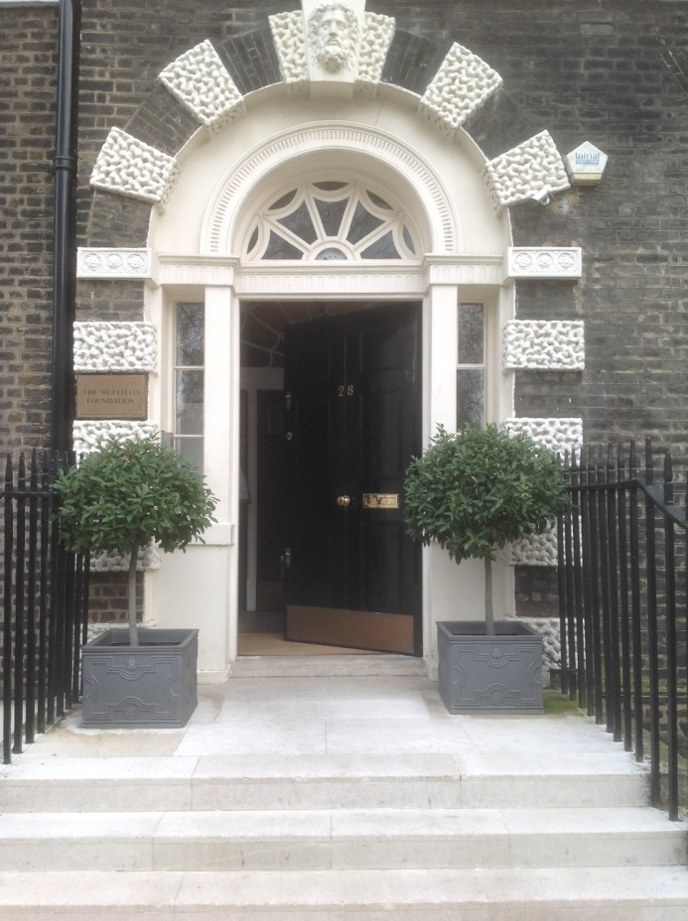







Thank you.
www.nuffieldbioethics.org
@nuffbioethics
nuffieldbioethics.org/blog
pmills@nuffieldbioethics.org

Slide 10
So: what’s distinctive about the Nuffield report?
We don’t start with the technology (genome editing) but with the challenge (overcoming the givens of genetic inheritance)
Our aim is not to protect research (by segregating it from clinical use) but to identify possible pathways for responsible translation
We don’t frame our inquiry within an implicit medical frame (which only asks: 'how should we treat people?') but a critical moral frame (which begins by asking: 'why should we treat people?')
We don’t narrow our inquiry around a particular ‘permission’ question (‘Should we allow…?’) but broaden the frame of evaluation to encompass alternative pathways (we consider the options as well as the choices)
We do not focus only on innovation (the next step) but also consider technology diffusion and repurposing (future states of affairs that we would prefer to secure or to avoid)
Instead of trying to bring specific cases under ambiguous abstract principles, we attend to the social dimension of how agency is situated in a contingent, dynamic context (allowing that experience can transform norms)
We don’t focus only on instances but also on circumstances (we don’t think the justification for permitting human genome editing is contained in the ontology of a clinical condition but depends on the medical, social and governance context as well)
We don’t think of public debate only as instrumental for policy (to inform particular decisions) but as the condition through which society can express its interest in the conditions of common life, as implicated in a system of interrelated moral norms and values

Slide 11


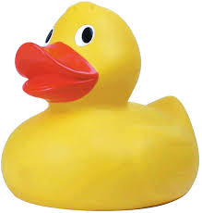

An international consensus?
“The human genome underlies the fundamental unity of all members of the human family, as well as the recognition of their inherent dignity and diversity. In a symbolic sense, it is the heritage of humanity” (Universal Declaration on the Human Genome and Human Rights, Art.1)
“In the fields of medicine and biology...the prohibition of eugenic practices, in particular those aiming at the selection of persons [must be respected]” (EU Charter of Fundamental Rights, Art.3(2))
“An intervention seeking to modify the human genome may only be undertaken for preventive, diagnostic or therapeutic purposes and only if its aim is not to introduce any modification in the genome of any descendants.” (Oviedo Convention, Art. 13)

Slide 12
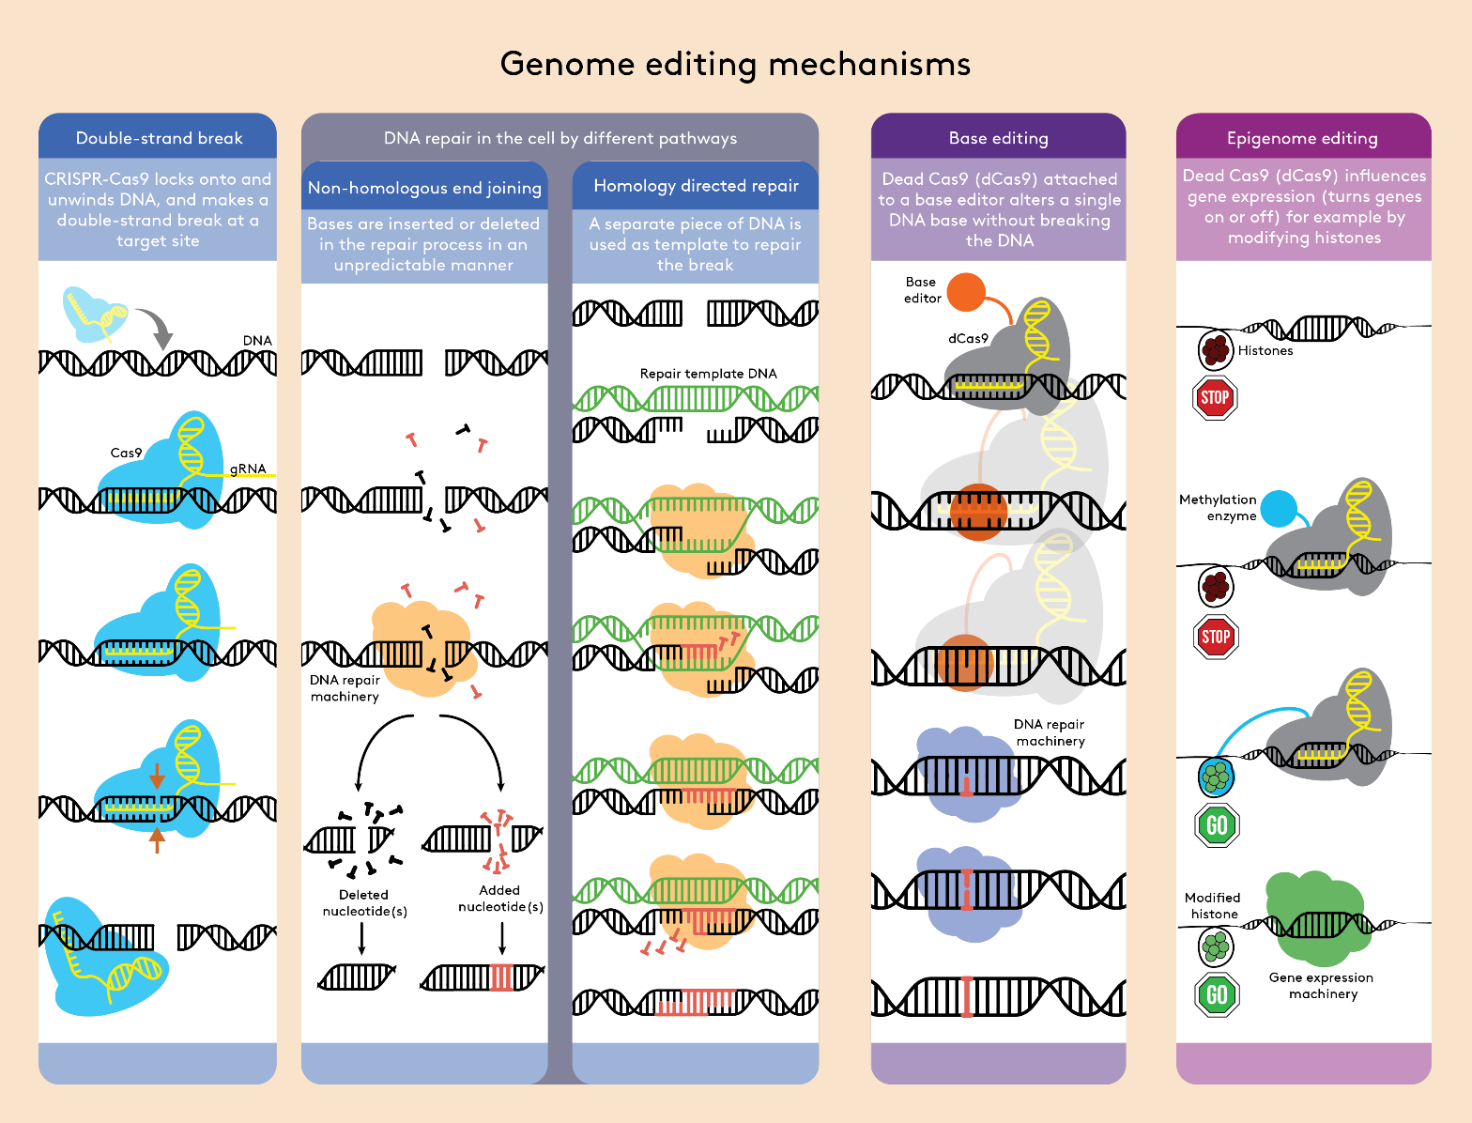
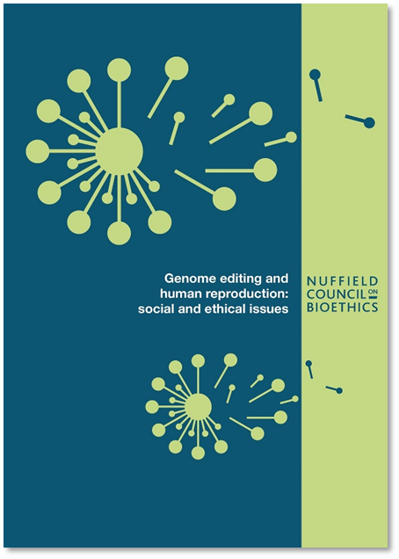

Slide 13
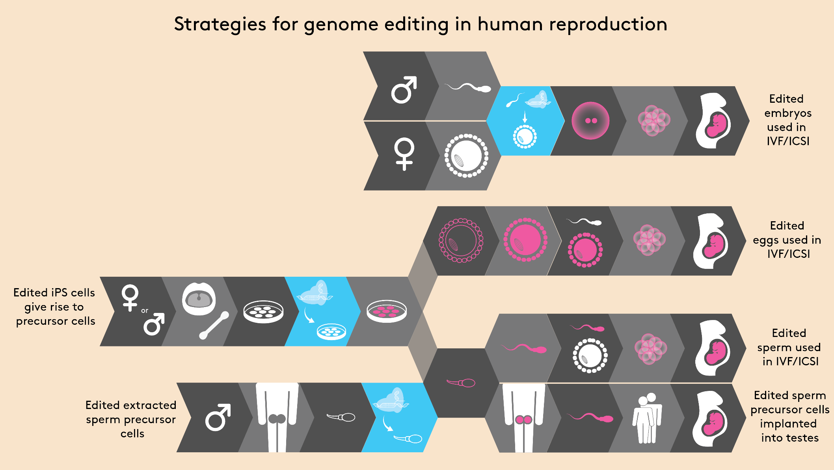

Slide 14
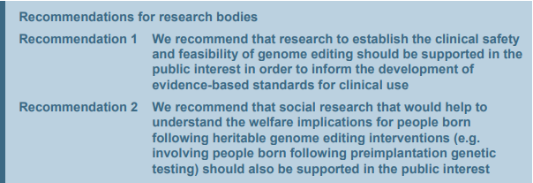
Recommendations for research

Slide 15
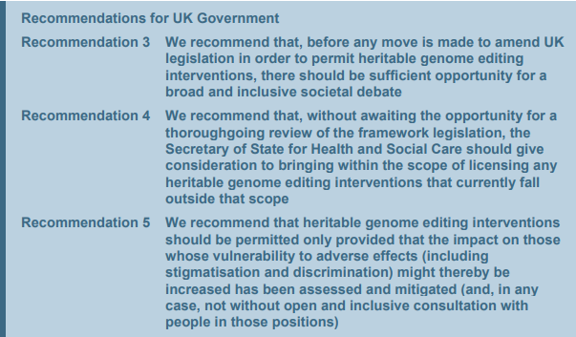
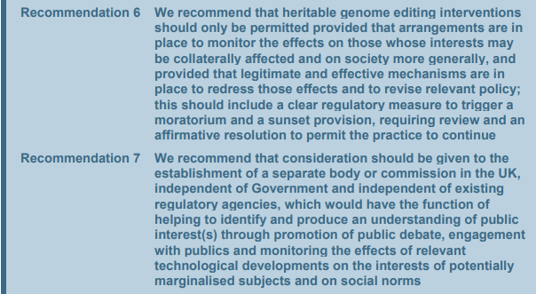
Recommendations for UK Government

Slide 16
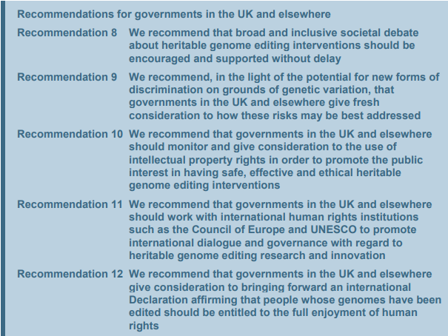
Recommendations for governments in UK and elsewhere

Slide 17
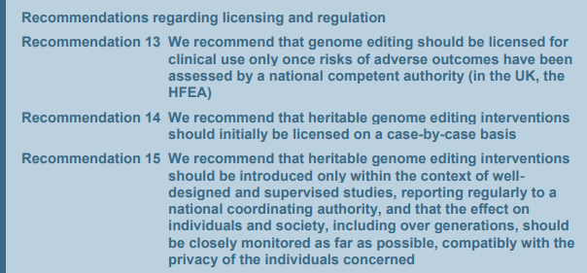
Recommendations for licensing and regulation

Slide 18
What is at stake for prospective parents?
They want to have a child, and
they want the child they have to be genetically related to them (otherwise the pre-established likelihood of the child having a pre-identified genetic condition disappears or, at least, changes), and
they want the child they have not to have a specified condition that there is a supposed likelihood that that child will have (which means, at the genetic level, they want the child to have one kind of genetic variant rather than another), and/or
they want the child they have to have a specified characteristic that there is a supposed likelihood that that child will not have (or, again, they want the child to have one kind of genetic variant rather than another).
i.e. they don’t want these children they want those children – though the motivation may be imponderable the decision about how to achieve that outcome involves deliberate agency.

Slide 19
The epistemic position
As a result of expanding genetic testing, genome sequencing and genomics research there is increasing:
understanding of the role and functioning of the genome in humans, and
information about their genotype accessible to individuals
Prospective parents increasingly face reproductive decisions equipped with genetic information that has practical significance in a given context of action

Slide 20
The sociotechnical context
Given access to certain genomic knowledge and genotype information, prospective parents can potentially decide
to refuse the information (although, in the context in which the information would be available this is, nevertheless, a moral choice) or
to act on the information; there are many options available, including:
not having a child, or
having a child who is:
not genetically-related, through:
adoption, or
gamete donation (intra familial, extra familial), or
genetically-related, through:
selective methods, such as:
prenatal (PND/ToP) or
preimplantation (PGD), or
editing methods (HDR, base editing, epigenome editing)
Methods other than genome editing could result in a genetically related child while excluding/including a heritable genetic trait in all but a very small number of cases.
That’s not really the point, however...

Slide 21



What’s new?
People approach reproduction in
novel epistemic position (genomic research, genetic testing)
novel technoscientific conditions (ARTs, reprogenetics, GE?)
Technological perspective
dynamic relationship between technology and norms
what role for moral agency?
what next?

Slide 22
Context and questions
So, there are two major considerations:
the epistemic position from which people confront complex reproductive decisions, and
the sociotechnical context in which they do so, which defines the options they have for exercising their agency.
In theory, people are responsible for their decisions but…
… society is responsible for their options.
The epistemic position (new knowledge) and the sociotechnical context (new powers of agency) create new conditions of responsibility for individuals and for society
How should we think about the relationship between these interests and responsibilities? In what circumstances, in what ways and to what extent should people be permitted, enabled and assisted to pursue their goals?
If the technology proves safe and effective, what further uses might we find for it? How should we shape the future innovation, diffusion and application of heritable genome editing technologies to secure the sort of society we want?

Slide 23
Relating responsibilities
Humanity
(human dignity)
the categorical problem
Society
Other cultures, future generations
social justice and solidarity
the distributional problem
Family
Others
welfare of the future person
the substantive problem
Prospective parents
Offspring

Slide 24
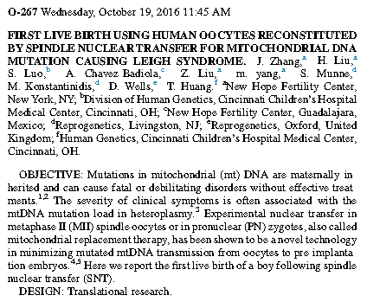
Technology transfer and ‘geo-ethics’
Knowledge, biological samples, technologies, experts and patients are internationally mobile
Concerns about technology transfer and equity
“In relation to possible applications, of most concern is the potential for treatments based on gene editing techniques to be offered prematurely and to find ready customers on the international health market, ahead of adequate tests to determine safety and efficacy.”
Chan S and Medina Arellano M (2016) Genome editing and international regulatory challenges: Lessons from Mexico, Ethics, Medicine and Public Health 2(3): 426-434

Slide 25
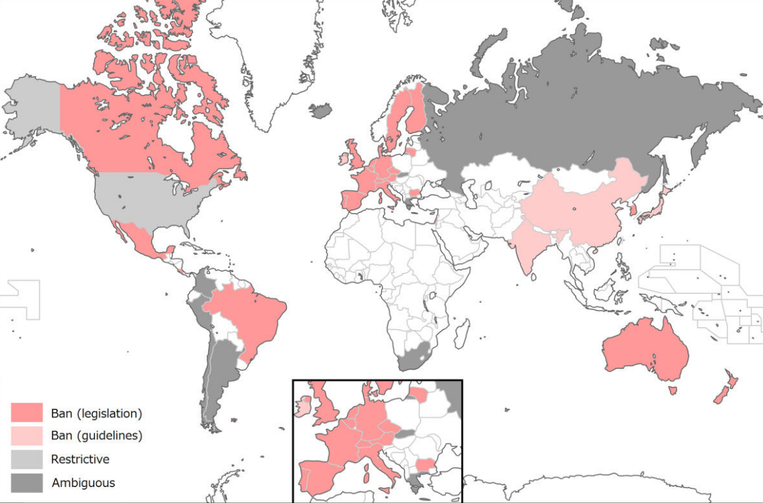
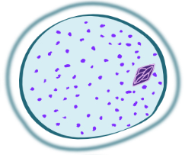


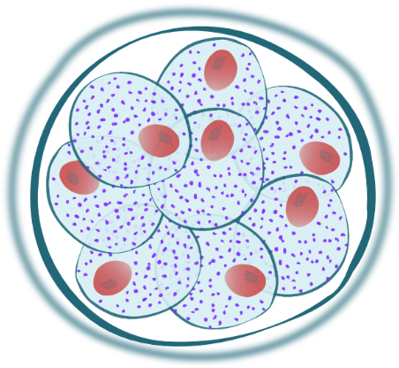
Map image from: Araki M and Ishii T (2014) International regulatory landscape and integration of corrective genome editing into in vitro fertilization, Reproductive Biology and Endocrinology 12:108
see also: Palacios-González C and Medina-Arellano M (2017) Mitochondrial replacement techniques and Mexico's rule of law: on the legality of the first maternal spindle transfer case, Journal of Law and the Biosciences 4(1): 50–69
Notes:
2016 case of Mitochondrial donation, where Jordanian patients of a New York fertility clinic were treated in Mexico, with some of the tissue analysis done in the UK. (When I asked the UK embryologist involved about the case they pointed out they had only done some confirmatory testing). “The procedure was carried out in the Guadalajara branch. Unfortunately, Zhang was quoted in the publication that broke the news as stating that he and his team went to Mexico because, in Mexico, ‘there are no rules’” ‘the ovarian stimulation cycles and oocyte manipulations were carried out at a private fertility clinic in New York, the vitrified embryo was then shipped to Mexico to be warmed and transferred to the patient at an affiliate clinic in Guadalajara’.

Slide 26
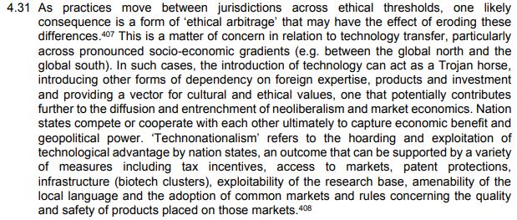
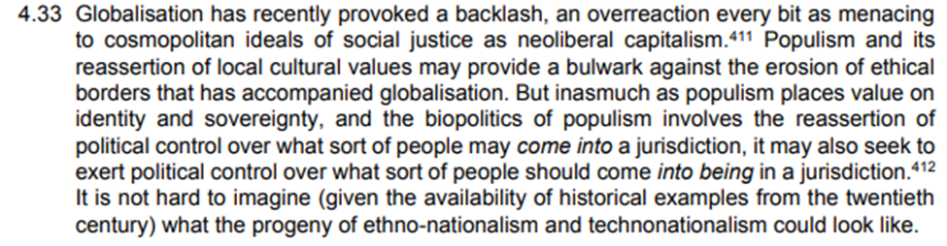
The need for a ‘geo-ethics’

Slide 27
Three venues of international discourse
Republic of science
Cosmopolitan ethics
Geopolitics and human rights
The third venue includes those who are attended to but not reflected in the republic of science, and incorporated but not represented/expressed in the political discourse.

Slide 28
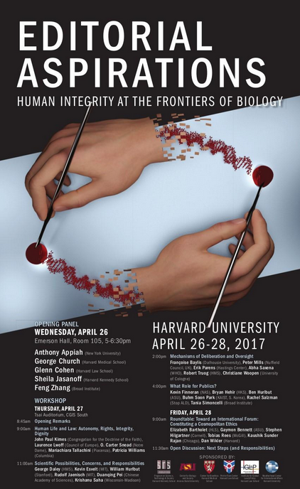

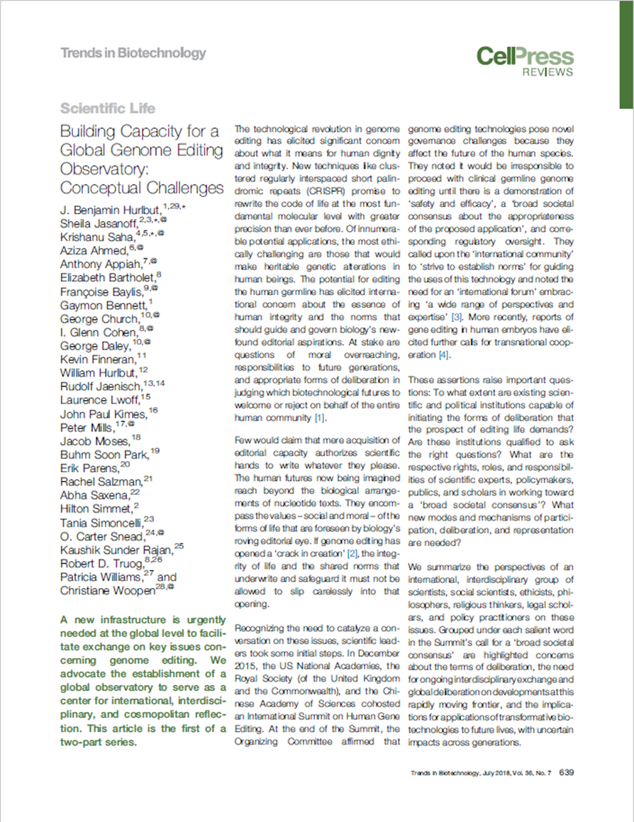
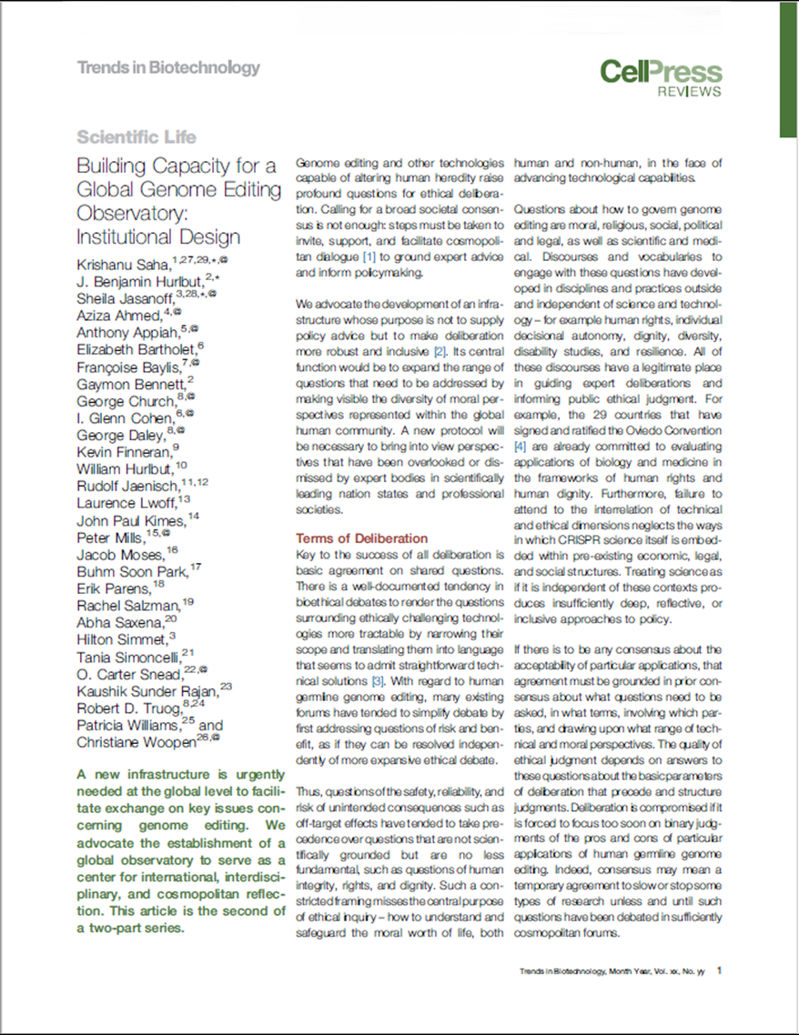
A global observatory for genome editing

